Slide 1
Enhancing Naïve Bayes with One-Dependence and Adaptive Weighting
James Beck, Jia Mody

Slide 2

01
Objective

Slide 3
Our Objective
Challenges with Independence Assumption
Naïve Bayes in ML
Simple, efficient, effective
Unrealistic in real world scenarios
Modifications for Real-World
Our Approach
Relaxing independence while maintaining efficiency
One-dependence estimators and adaptive weighting

Slide 4
02
Dataset/Preprocessing

Slide 5
Our Dataset
Kaggle | Instances | Attributes
Predicting house prices based on 12 attributes | 545 instances, no missing values | 12 attributes (i.e. # br, area, guestroom, furnishing status)

Slide 6
Preprocessing
Discretization
No missing values
No normalization
Discretized area and price, did not follow suit with others
No missing values, no need to
replace
Naïve Bayes does not require normalization

Slide 7
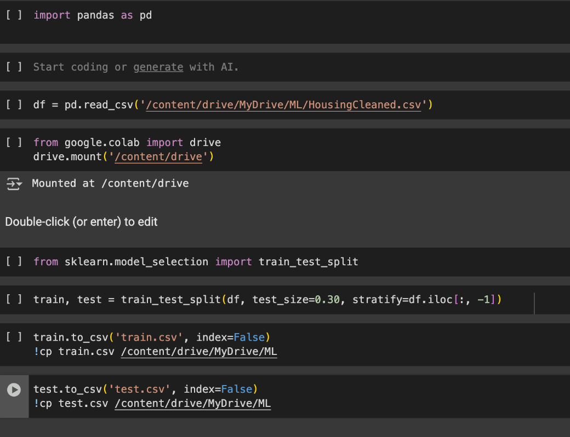
Train Test Split
Training
436/545 instances--80%
Testing
109/545 instances--20%

Slide 8
03
Our Algorithm

Slide 9
Related Work
01
AODE
Averaged One-Dependence Estimators
Small & Intermediate Datasets
02
AISWNB
Artificial Immune System
O(n x m x w² x a)
03
WANBIA
Conditional Log Likelihood
Mean Squared Error
04
LWNB
Locally Weighted
Algorithm Complexity

Slide 10

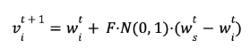
Our Algorithm
Superparent TAN
AISWNB
weight vectors are initialized
Vectors are fitted to training data
Instance is allowed to dependent on parent.
CMI (nonlinear) vs Cramer’sV (linear)
Notes:
t represents the current generation.
wᵢ is the vector being mutated.
wₛ is the best-performing vector.
N(0,1) is a normally distributed random variable.
F is a variation factor based on performance.

Slide 11
04
Experimentation

Slide 12


Experiment Overview
Smoothing
CMI and Cramer's V to Select Parent
Test multiple k values to find the optimal smoothing degree for handling unseen attribute-label pairs in Naive Bayes.
Compare CMI (attribute dependency with class) and Cramer'sV to select the super parent.
AISWNB Improvement Threshold
Experiment with the number of generations (m) and improvement threshold (T) to balance accuracy and training time.

Slide 13
05
Discussion

Slide 14
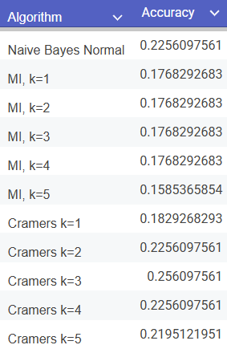
Results

Slide 15
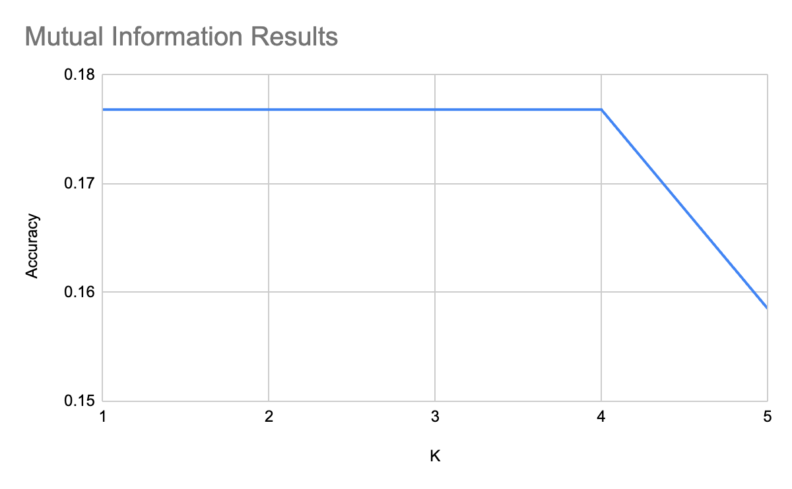
Mutual Information Results

Slide 16
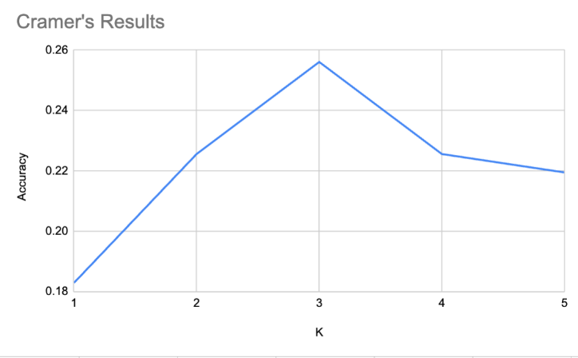
Cramer’s Results

Slide 17
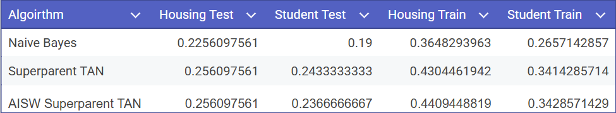
AISWNB
Runtime: 3.6s vs. 33.62s!!

Slide 18
06
Conclusion

Slide 19
Conclusion
Results
Best k value: 3
Best algorithm: Cramer’sV, AISW w/ Superparent TAN
Future Studies
Expanding project to more complex datasets
Multiple dependencies
Vast array of datasets
Optimizing attribute weighting

Slide 20
Thanks!
Do you have any questions?
Please keep this slide for attribution

